Slide 1

BANGALORE INSTITUTE OF TECHNOLOGY
K.R Road, V.V Pura, Bengaluru-04
DEPARTMENT OF INFORMATION SCIENCE & ENGINEERING
INTERNSHIP PRESENTATION ON
“JOB PORTAL”
USING FULL STACK WEB DEVELOPMENT
UNDER THE GUIDANCE OF :
PRINSTON SMART ENGINEERS
PRESENTED BY:
B M PAVAN (1BI21IS023)

Slide 2
CONTENTS
Abstract.
Introduction.
Company Profile.
Problem Statement.
Technologies Used.
Website Structure.
Requirements Specification.
Implementation.
Snapshots.
Conclusion.

Slide 3
ABSTRACT
The field of web development involves creating websites for the Internet (World Wide Web) or private networks (intranets). It encompasses a spectrum of tasks, from developing simple static pages to intricate web applications, electronic businesses, and social network services.
The Job Portal website is a dynamic online platform designed to meet the specific needs of job seeker and provider. Focused on providing an engaging user experience, this digital portal showcases a comprehensive database of job and company, ensuring a seamless browsing and management journey for users looking for jobs.

Slide 4
INTRODUCTION
1.Aim of the Project
The website is designed to offer a smooth and delightful experience for individuals looking to jobs and find suitable job.
2.About the Project
The Job Portal website is a user-friendly online platform that combines the importance of blood donation, the convenience of managing donations from home, and the simplicity of user-friendly features. Developed using React.js, CSS, JavaScript, Node.js and MySQL, the project blends various functions, providing a straightforward platform for Job seekers, along with interactive features like easy login. With a visually appealing design and smooth user interactions, our goal is to make the online experience efficient and enjoyable.

Slide 5

COMPANY PROFILE
Name : PRINSTON SMART ENGINEERS
Main Office : Vishnuvardhan Statue Rd, Vishwa Priya Nagar, Begur, Bengaluru, Karnataka, 560068
Phone : 9513106196
Email : Prinston.Smart@gmail.com
Contact Person: Mrs. Farheen Farhath (Managing Director)
Year stand up : 2004
Company category : IT Software/ Embedded

Slide 6
PROBLEM STATEMENT
The task is to create a complete Job Portal Management website with at least four pages. The focus is on engaging users, showcasing donation events effectively, and ensuring easy navigation.

Slide 7
TOOLS AND TECHNOLOGIES
Frontend (React UI): Frontend is built using React and offers an intuitive user interface for job searching and job posting.
Backend (Node.js): Backend, powered by Node.js, handles incoming requests from the frontend and communicates with the database
Database (SQL): SQL stores job listings, user profiles, and application details, facilitating efficient querying and search functionalities for the job portal.

Slide 8
WEBSITE STRUCTURE
Header: The header of the Book Delivery website features the logo for brand recognition, intuitive navigation buttons for seamless exploration, a dedicated cart icon for easy shopping management, and a user icon.
Content: The content section of the Book Delivery website showcases visually appealing product images, themed pictures illustrating the joy of reading, interactive forms for user engagement, and informative headlines and paragraphs detailing book features and reading tips.
Footer: The footer of the Book Delivery website contains navigation links for easy access to all essential pages, contact information including phone numbers and email addresses for user queries, and links to other websites such as Instagram and LinkedIn.

Slide 9
REQUIREMENTS SPECIFICATION
Hardware requirements
Processor: i3 Core Processor
Keyboard: QWERTY
I/O Device: Standard input and output devices.
Software requirements
Operating system: Windows 10
Development Environment: VS Code
Dependency: Live Server

Slide 10
IMPLEMENTATION
1. Created one folder in VS Code.
2. Created all the necessary pages for each link and the functionalities.
3. Style all the Web pages.
4.Designed cart page with the help of javascript.
5.Implemented all the required pages with the help of frontend technologies.

Slide 11
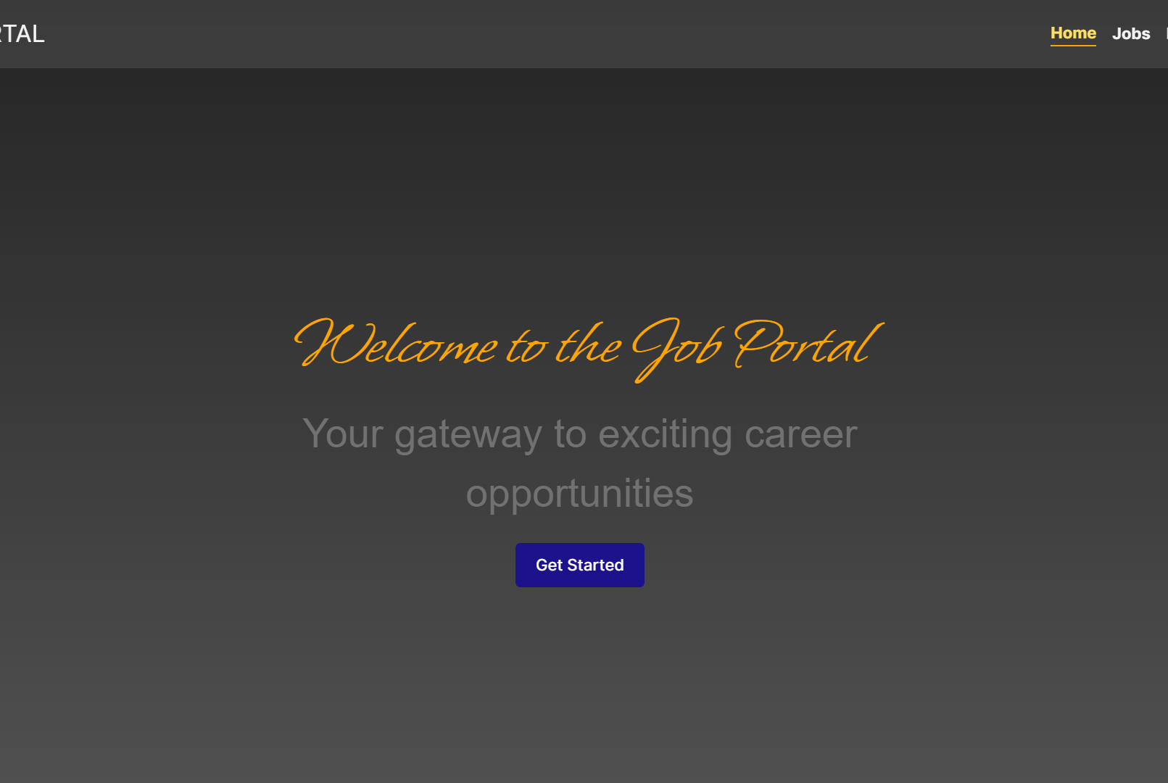
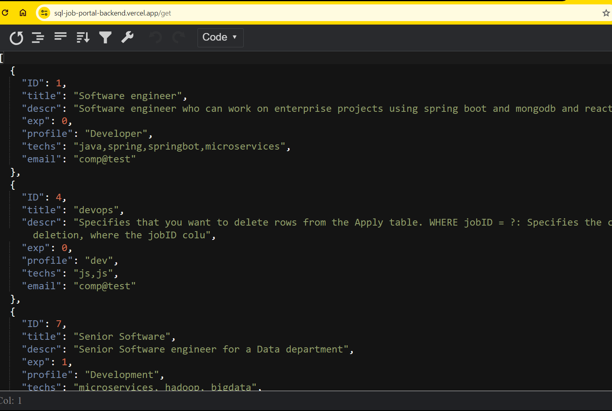
RESULTS
Visit Job Portal (https://dbms-bm9avan.vercel.app) for demo

Slide 12

CONCLUSION
In conclusion, the job portal project successfully achieves its goal of providing an efficient platform for job searching and posting. The integration of Spring Boot, MongoDB, and React results in a user-friendly interface that caters to both job seekers and employers.

Slide 13
THANK YOU

